Slide 1
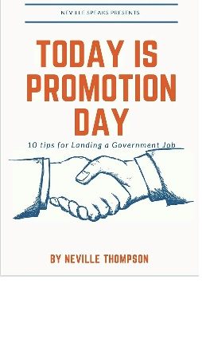
BIG Promotional Special
Motivational Book
+
Career Book
+
1 hour of speech coaching
Price $80.00
-

